Slide 1
CS 416 Web Programming Database Connectivity
Dr. Williams
Central Connecticut State University

Slide 2
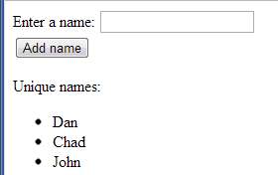
Review from last class – sample problem
Create a servlet to do the following (use ReviewNames.java as your starting template)
Servlet displays page and GETs to itself
User is able to submit names
At the end of the page output unique names that have been entered across all sessions

Slide 3
Database connectivity
Any non-trivial business application relies on a database
Dynamic content through retrieving changing data from a database
Essentially all sophisticated applications both read and write to the database

Slide 4
Database interaction
Two of the key ways of accessing relational data in Java EE are
Java Database Connectivity (JDBC)
Standard API for Java applications to interact with a database
Although not part of Java EE it is very frequently used in Java EE applications
Java Persistence API (JPA)
Tools for mapping database entries to objects and persisting objects back to the database

Slide 5
Creating a JavaDB instance
In NetBeans
Go to Window|Services
Expand Databases
Right click on Java DB click start server
Right click Java DB and choose Create database

Slide 6
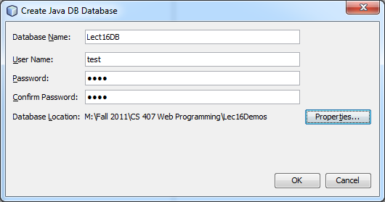
Create instance
Lect8aDB
Password:
pass
APP
Change location to be directory where your project is
This isn’t required, but makes it easier for making sure you submit all of your files to me

Slide 7
Creating schema
Right click created instance and choose connect
Expand and right click APP and select Set as default schema
Click to expand APP

Slide 8
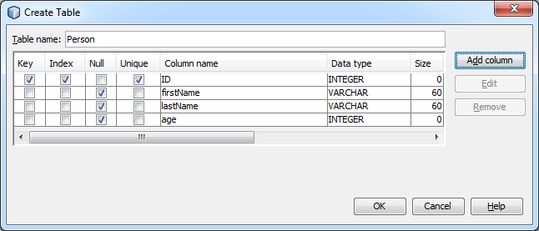
Create PERSON table
Right click Tables folder and choose create table

Slide 9
Create data
Right click person table and choose view data
Click on insert records icon
Click on fields within table to add 3 records

Slide 10
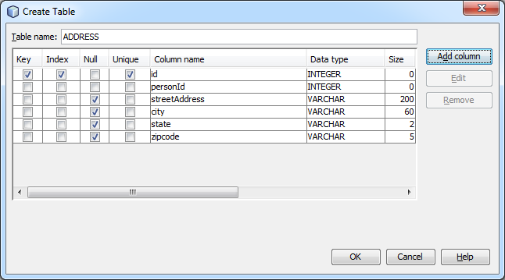
Create ADDRESS table

Slide 11
Add foreign key constraint
Right click tables and select execute command
This can be used to execute any sql command on the database
Enter the following to create a foreign key to person
ALTER TABLE APP.ADDRESS
ADD FOREIGN KEY (PERSONID)
REFERENCES APP.PERSON(ID)
Add an entry to ADDRESS table

Slide 12
Select SQL cheat sheet
select * from PERSON
select id,firstname from PERSON
select * from PERSON where id=?
select * from PERSON where firstname like ?
? - "Bob%“
Join tables:
select P.firstname, A.city from PERSON P, ADDRESS A where P.ID = A.PERSONID

Slide 13
Executing queries
In execute command window write:
Select * from person
Execute a select with a join
select p.firstname, a.city from person p join address a on p.ID = a.PERSONID

Slide 14
Working with our database
JDBC allows us to connect and execute queries against a database
Most common way to access data (and best way through JDBC) is through java.sql.PreparedStatement
Two operations
ExecuteQuery – executes a SELECT statement and returns a ResultSet
ExecuteUpdate – executes INSERT, UPDATE, DELETE and returns the number of rows affected
(alternative is Statement.execute, but can have bad security implications if you aren’t very careful)

Slide 15
Connecting to our database
Once the database has been created and the schema populated next is registering the database with the application server
Create a connection pool – allocates a certain number of connections to the database, applications within the application request connections from the pool and return the resource when they are done
Register the Pool in the Java Name Directory Interface (JNDI) – specify name that can be used to look up the datasource

Slide 16
Creating the connection pool
Open the Glassfish administration console
In NetBeans go to Windows|services
In the left pane expand servers
Right click GlassFish server and start it if needed then click View Admin Console
Either select “Create New JDBC Connection Pool” off intro page or click JDBC Connection Pools and then click New

Slide 17
Creating the connection pool cont.
Give the pool a name: lect8apool
Change the Resource type to: javax.sql.DataSource
Change the Database Driver vendor to: JavaDB
Click Next

Slide 18
Creating connection pool cont.
In the Pool settings you can configure the size of the pool, how the pool grows, and timeout - for now leave the defaults
In the additional properties put:
User: APP
Password: pass
DatabaseName: Lect8aDB
ServerName: localhost
PortNumber: 1527
Delete SecurityMechanism
Click Finish
Test the connection:
Click the lect8apool
Click ping

Slide 19
Registering data source
Click the JDBC Resources folder
Click New
Enter jdbc/Lect8aDB
Change the pool name to: lect8apool
Click OK

Slide 20
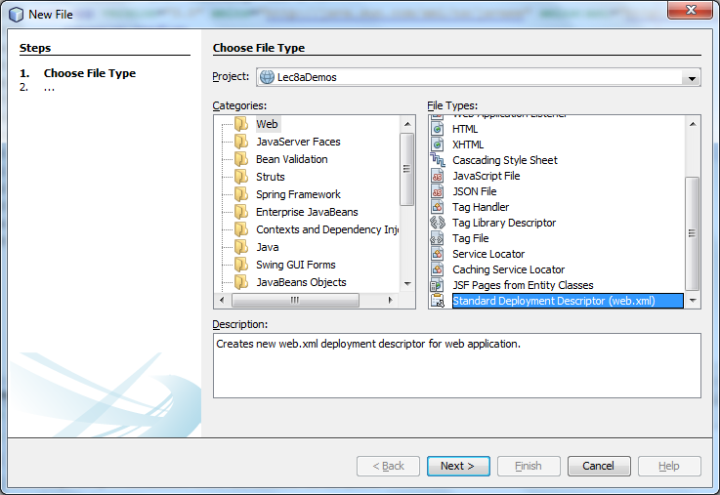
Registering resource in project
Right click on your sources folder and choose New|Other and then under Web pick “Standard deployment descriptor”

Slide 21
Add reference
Click on “References” across the top, then under Resource References click Add setting the resource name to “jdbc/Lect8aDB”
After it’s added click on Source at the top. In the source find the entry:
<res-type>javax.sql.DataSource</res-type>
Change it to:
<res-type>javax.sql.ConnectionPoolDataSource</res-type>

Slide 22
Connecting to our database
Within servlet add resource of our data source:
@Resource(name = "jdbc/Lect8aDB")
private javax.sql.DataSource datasource;
Within processRequest can now access database using:
String sql = "select * from PERSON";
Connection connection = datasource.getConnection();
PreparedStatement preparedStatement = connection.prepareStatement(sql);
ResultSet resultSet = preparedStatement.executeQuery();
while (resultSet.next()) {
out.println(resultSet.getString("firstName")+"<BR/>");
}
resultSet.close();
preparedStatement.close();
connection.close();
(Refer to edu.ccsu.DBTestQuick for example)

Slide 23
Prepared Statements
SQL statement that is compiled on DB first time it is used, making for very fast execution on subsequent calls
Also not susceptible to SQL injection attacks
Two common types of execution
executeQuery() - SELECT statement that returns a RecordSet object for working with the results
executeUpdate() - Executes INSERT, UPDATE, DELETE and returns an integer, the number of records affected by the update

Slide 24
PreparedStatement parameters
With prepared statements in addition to having plain SQL you can also specify dynamic parameters by using a question mark “?” as a place holder
sql = “select * from person where firstname like ? and age = ?
The parameters are then filled in by specifying:
preparedStatement.setString(1,”J%”);
preparedStatement.setInt(2,20);
Note index starts at 1 rather than 0

Slide 25
Application flow
A common application flow is to call a servlet have it retrieve/manipulate data add it to the request/session/context and forward it to another servlet or JSP for display
request.getRequestDispatcher("PersonDisplay.jsp").forward(request, response);

Slide 26
Insert statement cheatsheet
insert into PERSON values (?,?,?)
Note very problematic as depends on order of database columns if DBA changes these it breaks all of your code or worse
insert into PERSON (id,firstname) values(?,?)
One thing to pay attention to is needing to guarantee primary key is unique – we will cover better ways later, but one option is to get next value

Slide 27
Insert example
AddPersonServlet
Finds next primary key
Inserts new record
Forwards to allow other servlet to display

Slide 28
Update statement cheatsheet
update PERSON set firstname=?, lastname=? WHERE id=?
update PERSON set firstname=? WHERE lastname=? AND age=?
Note like delete, very dangerous if WHERE condition isn’t specific enough

Slide 29
Update example
UpdatePersonServlet
Update first and last name by specified id

Slide 30
Delete statement cheatsheet
delete from person where id=?
delete from person where firstname=? AND lastname=?
Very dangerous if WHERE condition isn’t specific enough

Slide 31
Delete example
DeletePersonServlet
Deletes based on name match (note could delete multiple records)

Slide 32
Input revisited – it’s magic!
One of the input types we didn’t touch upon earlier was hidden input
<input type="hidden" name="name" value="Chad"/>
Form element doesn’t show up on page but value of element gets submitted with rest of form
Why do I care?
Very useful for keeping track of identifier (or other info) without having to show it to the user!

Slide 33
Display names revisited
Revise DisplayNamesServlet to display names with submit button to direct to page to display that name by the id passed use GET
Create DisplayPersonServlet to display a name with the passed id with the first and last name in textboxes (will become apparent why later)
Take advantage of GET form using hyperlinks

Slide 34
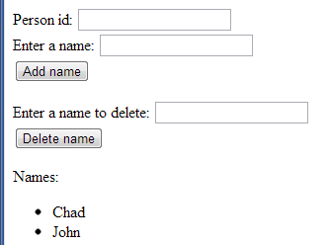
Review problem revisited (use ReviewRevisited.java as your template)
Create a servlet modeled off the review problem
When the person enters a name it should be added to the person table
Display should be done by reading from the database
Do not worry about whether the names are unique
If you have time, add functionality allowing you to delete a name

